Slide 1
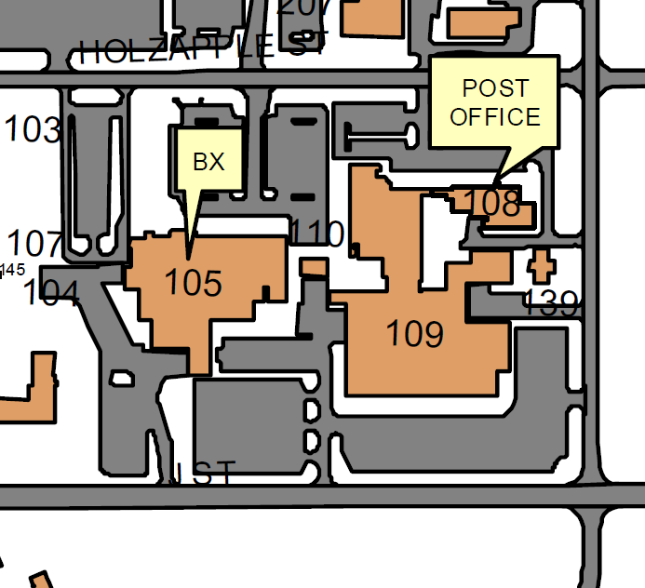
Remove Stop Sign east of Clinic (Building 109)
To be Removed
Rational: Due to the low speeds, no reports of accidents/near misses, and lack of risk at this location, the stop sign will be removed.
Change will be made no earlier than 09 August 2017

Slide 2
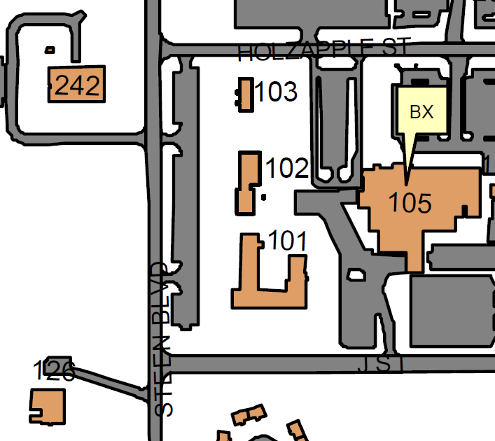
New Stop Signs
Two New Stops Signs
Rational: 319 CONF is planned to go into 242, potentially making the northern most exit/entrance into this lot more congested. Therefore, two new stop signs will be added. (NOTE: no change to parking lot southern exit/entrance due to clear sight lines and no reports of accidents/near misses.)
Change will be made no earlier than 09 August 2017

Slide 3
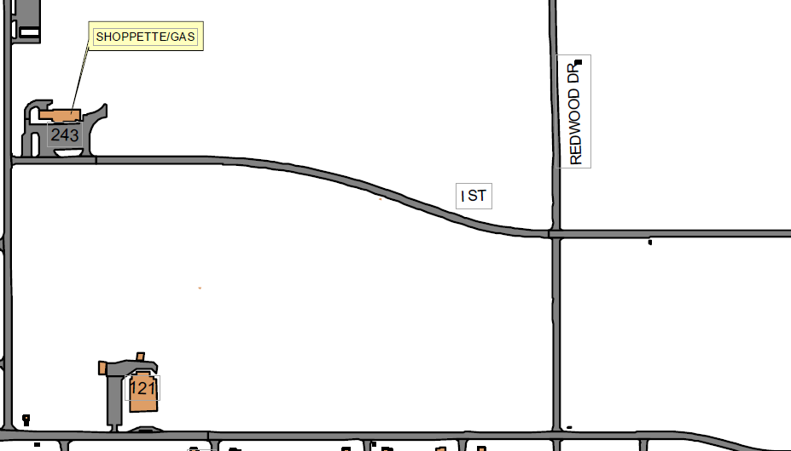
Redwood New Right of Way at intersection of I-Street
Relocate Stops Signs
Rational: With demolition of 200+ homes in this neighborhood the main traffic flow thorough this intersection is now along Redwood. Therefore, the stops signs on Redwood will be removed and reposted on I-Street.
Change will be made no earlier than 09 August 2017

