Slide 1
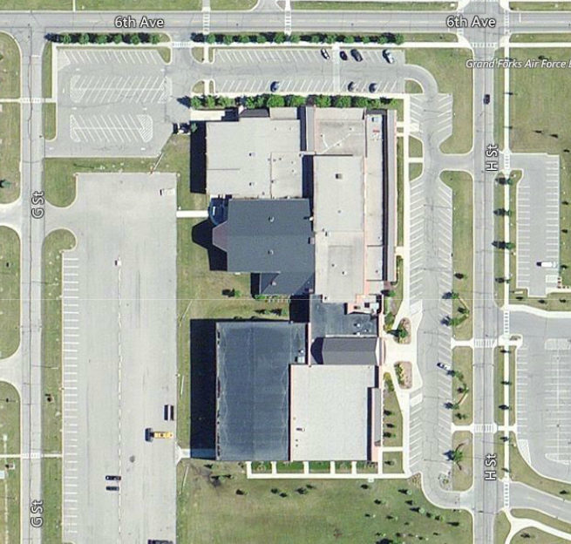
FITNESS CENTER PARKING LOT REPAIR
North Entry Lot
WHEN: Construction 3 Jul – 21 Aug
WHERE: North Parking Lot
WHO: 319th Civil Engineer Squadron
POC: Mr. Jim Rosinsky 747-4616
or Capt Ordorica 747-4604
FITNESS CENTER B308
3 Jul - 6 Aug Parking lot will remain open as Contractor repairs existing curb/gutter. Users are cautioned to avoid areas marked with orange cones as workers and equipment will be present.
***7 Aug -21 Aug Parking lot will be CLOSED*** as indicated by the blue shaded area to allow pavement replacement. The sidewalk leading to the north building entrance will remain open. The lot entrance/exit from Tuskegee to the west lot will be closed. Please use G street entrance/exit for the west lot.

