Slide 1
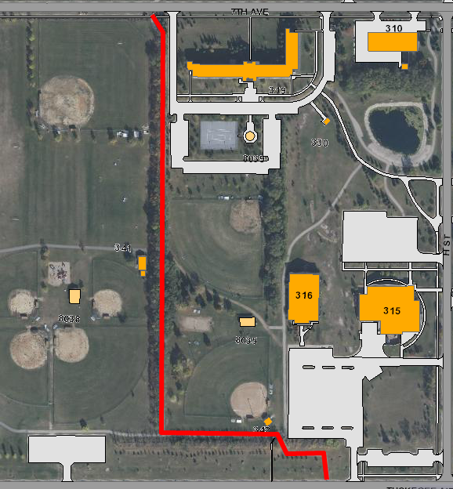
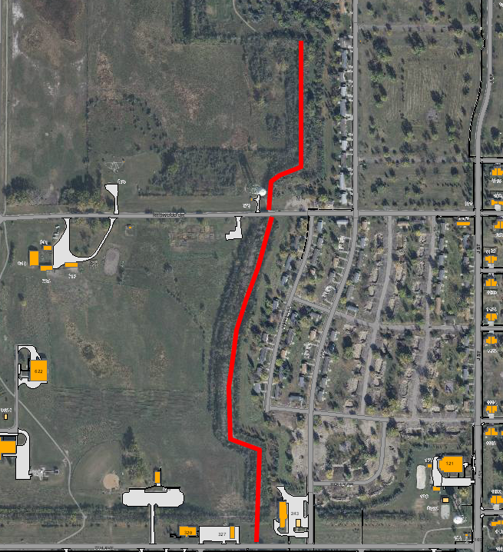
REPAIR MULTI-USE TRAIL FROM
TUSKEGEE TO REDWOOD DRIVE
7th Ave
WHEN: Construction 17 Jul –1 Sep
WHERE: Tuskegee to Redwood Drive
WHO: 319th Civil Engineer Squadron
POC: Mr. Jim Rosinsky 747-4616
or Capt Ordorica 747-4604
Redwood Drive
Tuskegee Amn Blvd
7th Ave
Segment 1 Segment 2
***Multi-trail will be CLOSED for repair as indicated in red from Tuskegee Airmen Blvd to Redwood Drive. Users are cautioned to avoid these areas as workers and equipment will be present.***

